Slide 1
"Parallelizing and Vectorizing Compilers"
Article by:
Rudolf Eigenmann
Jay Hoeflinger
Presented by:
Huston Bokinsky
Ying Zhang
25 April, 2013

Slide 2
Questions article wants to answer:
How does one write or rewrite code to execute serial algorithms on parallel devices?
What algorithms will allow a compiler to automate design decisions and translation of serial code to parallel code?
Notes:
Classic compilers are written for serial architectures. Vector and parallel architectures offer clear advantages for time and efficiency, but how to take advantage of them?

Slide 3
Parallel Programming Models
Vector Machines
Loop Parallelism:
Independent iterations = loop iterations that access separate data
Also called fork/join parallelism because of way work of successive iterations forked off to parallel processors then joined back
Static scheduling versus dynamic scheduling
Parallel threads
Single Program, Multiple Data (SPMD)

Slide 4
Program Analysis
Dependence Analysis:
Four types of data dependence
Iteration spaces
Dependence Direction, Distance Vectors
Dependence Tests: Exact vs. Inexact, Runtime Tests
Interprocedural Analysis
Symbolic Analysis
Abstract Interpretation (?)
Data Flow Analysis

Slide 5
Dependence Analysis Cont'd
Data dependence can be one of:
input dependence = READ b/f READ
anti-dependence = READ b/f WRITE
flow dependence = WRITE b/f READ
output dependence = WRITE b/f WRITE
A true (exact) dependence test is NP-Complete; working dependence tests use simplifying conditions and special assumptions. These can give reliable determinations in many cases, but are nonetheless inexact by themselves.

Slide 6
Dependence Elimination: Data Privatization and Expansion
Data Privatization and Expansion prevent anti- and output dependences by keeping one iteration from updating a data value before another iteration uses the old value.
Privatization = assign new value to separate storage location
Expansion = place occurrence of updated value into private storage of each parallelized processor

Slide 7
Dependence Elimination: Reductions, Inductions, Recurrences
Code transformations to eliminate areas where we need to wait for one iteration to produce a value needed for a successive iteration.
Generally, dependence elimination is realized by expressing a computation in a different way (without accounting for a previous value)...

Slide 8
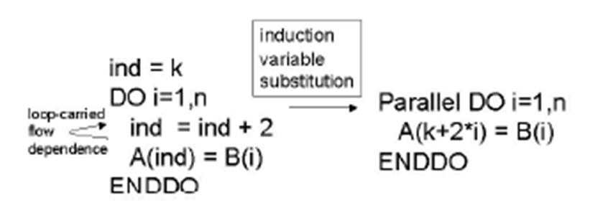
Dependence Elimination: Inductions
Induction Variable Substitution: find instances where variables are modified by each iteration of loop in predictable way (eg. geometric progression, successive incrementation, ...)
Replace these variables with expressions involving loop indices.

Slide 9
Dependence Elimination: Reduction
Variation on the theme of array reduction.
Typical use = array summed to scalar variable.
Elements of array manipulated by parallel processors, then summed by serial loop.
Note that there is still a serial summing, but time is saved by distributing manipulation of addends across parallel structure.

Slide 10
Dependence Elimination: Recurrence
Sometimes serial computations depend on several values preceding the current iteration. If a recurrence relation (from Discrete Math) can be found, the process may be parallelized by substituting the recurrence relation into the iteration.

Slide 11
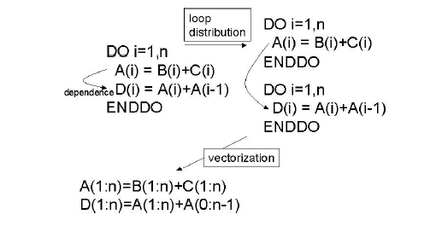
Loop Transformations: Vector Arch.
Loop Distribution: when iterations contain dependencies between multiple tasks, iterations can be spread out over a vector and the tasks within each iteration broken up.

Slide 12
Loop Transformations: Multiprocessors
Loop Fusion
Part of Increasing Granularity Series...
Loop fusion combines two or more loops into one.

Slide 13
Loop Transformations: Multiprocessors
Loop Coalescing
Part of Increasing Granularity Series...
Loop coalescing merges two nested loops into one. Note mutation being performed on i and j in each parallel iteration.

Slide 14
Loop Transformations: Multiprocessors
Loop Interchange
Part of Increasing Granularity Series...
By moving an inner parallel loop to an outer loop, fork/join overhead is only incurred once during operation...

Slide 15
Where does it fit in our course content?
(Data dependence analysis and loop structure analysis happen late in the compilation process.)
Runtime organization: how to data structures and control variables to allow parallel processes to eliminate data dependences?
Code generation: how to write (or rewrite) code from serial architecture to parallel architecture?

