Slide 1
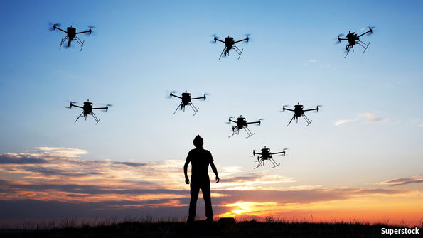
Power and Energy
Distribution
Fuel Cells
Combustion
Batteries
Mobile Nuclear
Materials
Thermoplastics
Additive metals / comp.
Multifunctional
Sensing
Prognostics
Autonomy
Artificial Intelligence
and
Communications

Slide 2
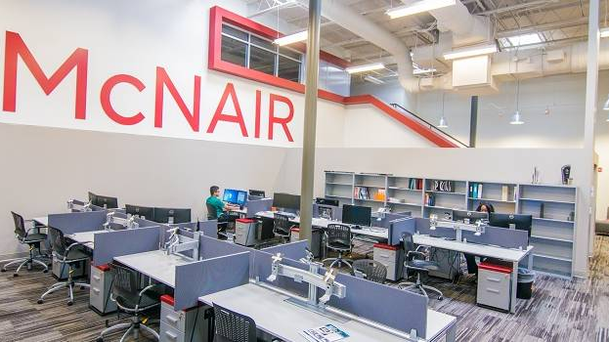
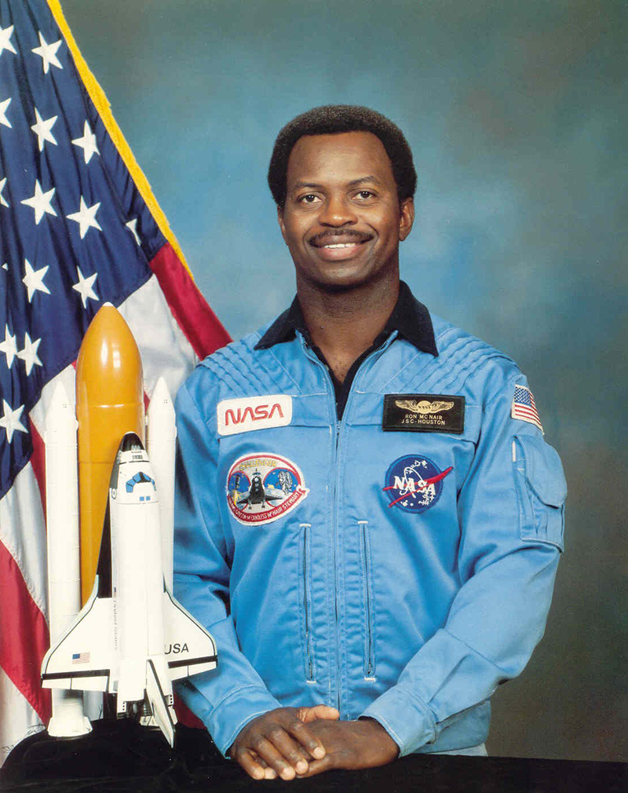
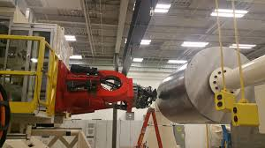
Before you can make a dream come true, you must first have one. Ronald E. McNair (laser physics, MIT)
Initiated 2013
Darla Moore, Anita Zucker, Marva Smalls
BOEING - research initiation

Slide 3
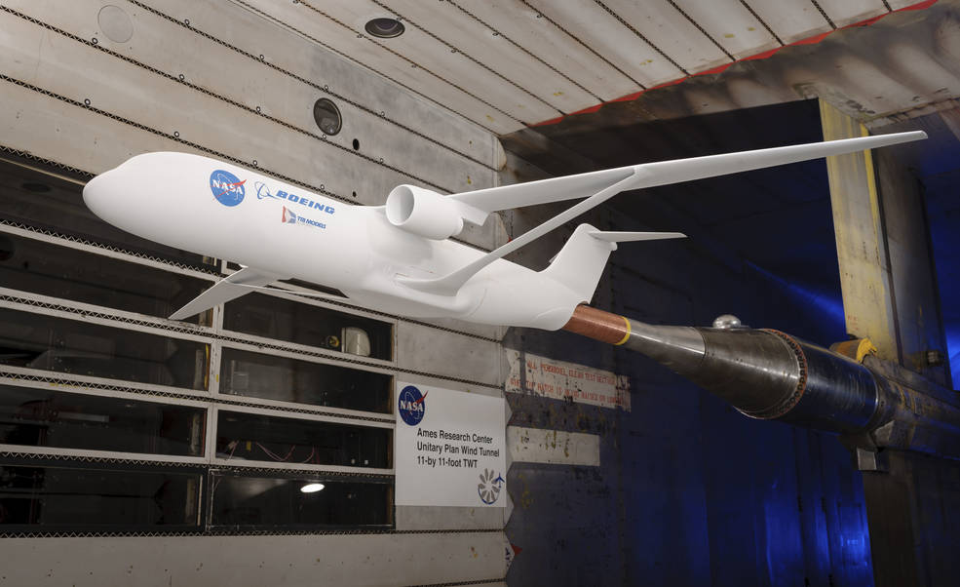
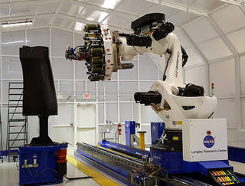
Advanced Composites Project
(2014 – 2019)
Improved methods, tools, and protocols to reduce the development and certification timeline for composite materials and structures.
TECHNICAL CHALLENGES
Accurate Strength and Life Prediction Develop validated strength and life prediction tools with known accuracy for complex composite structures.
Rapid Inspection & Characterization Develop and demonstrate NDE systems and enabling technologies in complex composite structures.
Efficient Manufacturing Process Development Develop and demonstrate new computational methods to relate manufacturing parameters to defect formation while resolving manufacturing issues.

Slide 4
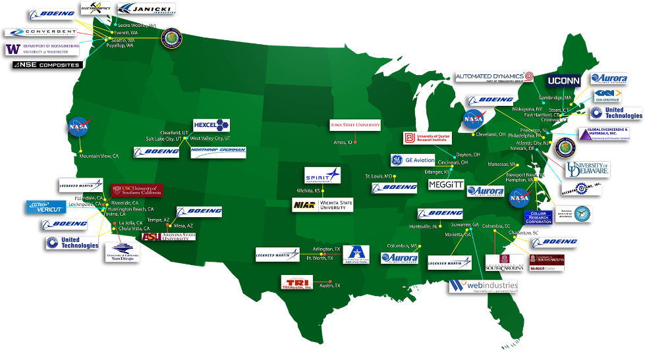
Advanced Composites Consortium
High-rate manufacturing concepts (TRL/MRL 3+ ➔ 6)

Slide 5
Digital Twin Technology for Navy P&E Systems

Slide 6
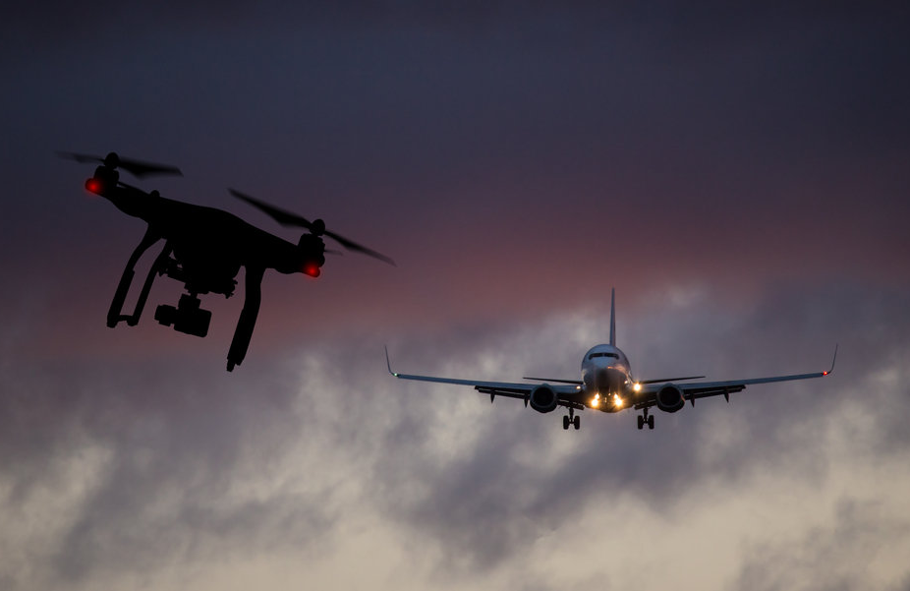
Hyper-Spectral Communications & Networks for Air Traffic Management
Robust, efficient, reliable, secure aviation communication & networking
Multi-band air-ground communications, mmWave links, ConOps, advanced simulations

Slide 7
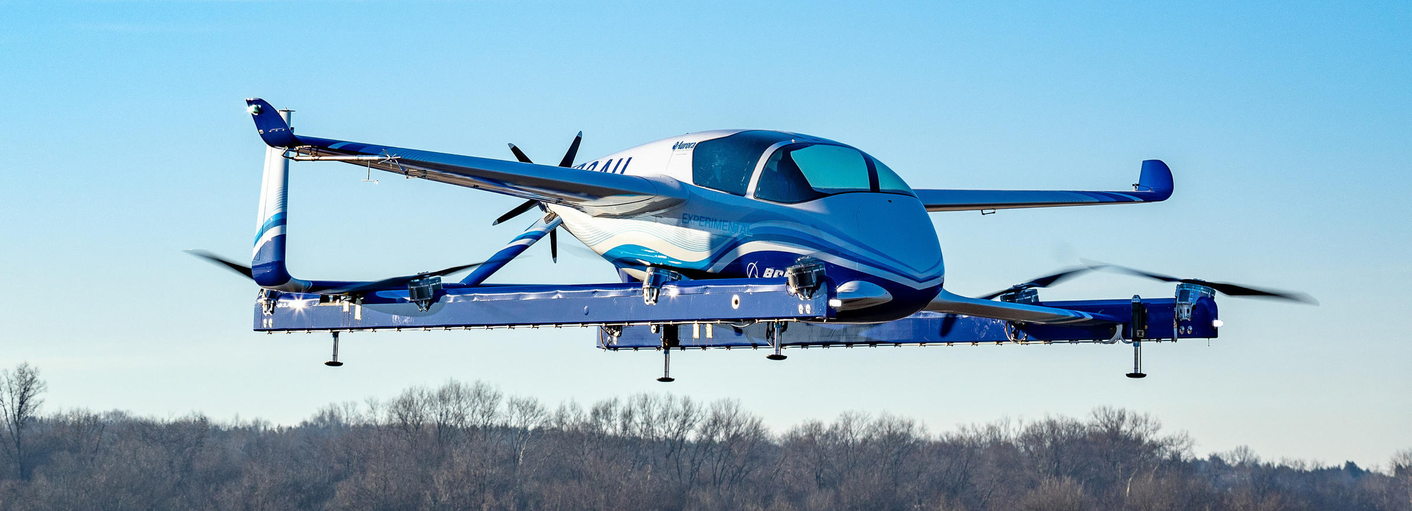
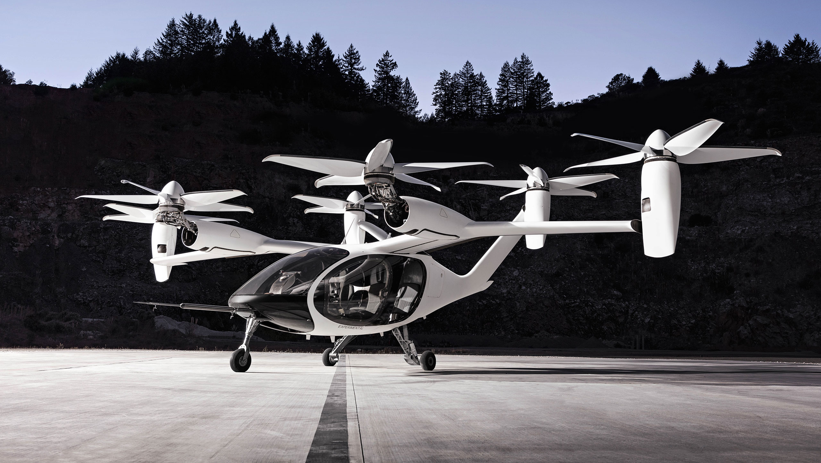
University Led Initiative (ULI)
Synthetic Design Synthesis of Fastener-free assemblies for Urban Air Mobility vehicles
10+ industrial partners
‘Atoms to Aircraft to Spacecraft’
(TRL/TML 2+ to 6)

Slide 8
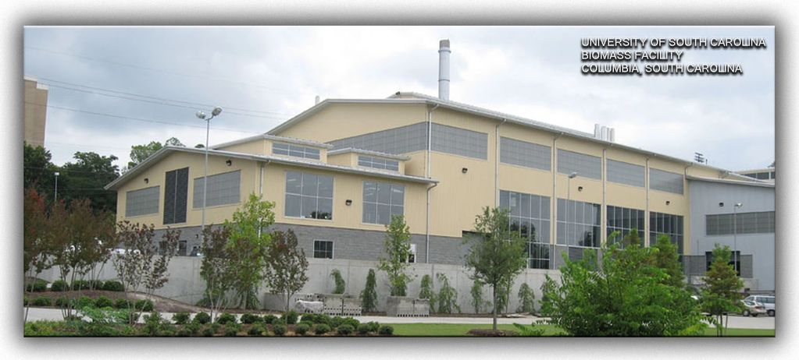
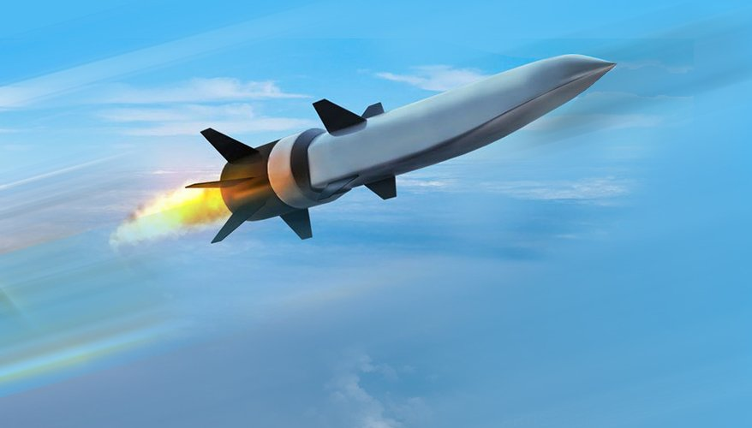
UofSC's Advanced Hi-Rate Manufacturing capabilities build on $60 million of investments and applied research funds.
TRL 3
TRL 6
Hi-Rate Composite Aircraft Manufacturing (HICAM)
TRL 3
TRL 6
Advanced Composites
Project (ACP)
Advanced Composites
Project (ACP)
https://breakingdefense.com/2019/06/raytheon-northrop-will-soon-fly-hypersonic-cruise-missile/
TRL 3
TRL 6
Thermoplastic Composite
Welded Assemblies
TRL 2
Digital Engineering for Hi-Rate Hypersonics Manufacturing
ULI Atoms to Aircraft to Spacecraft
TRL 6
TRL 3
TRL 6
Digital Twin Technology for Navy Power & Energy Systems
TRL 2
TRL 5
TRL 5
Manuf. of C/C Composites
for Hypersonic Applications (MOC3HA)
Cognitive Digital Twins for Smart Manufacturing

Slide 9
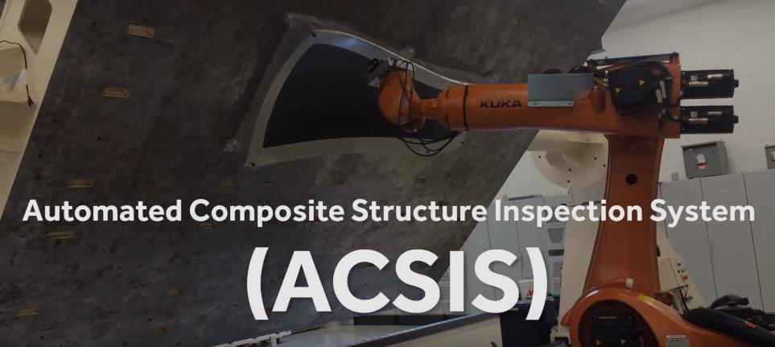
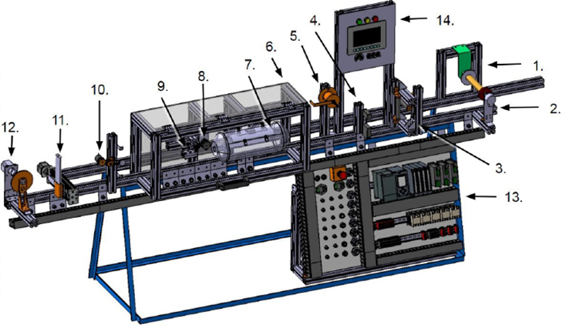
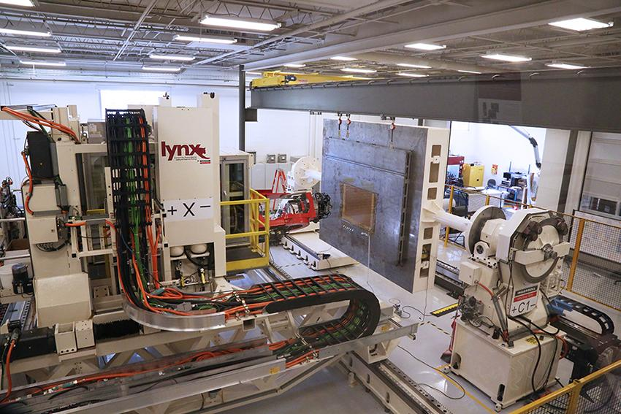
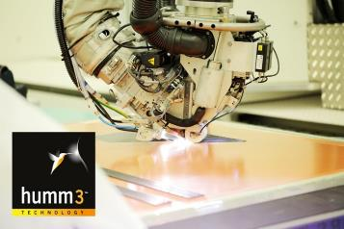
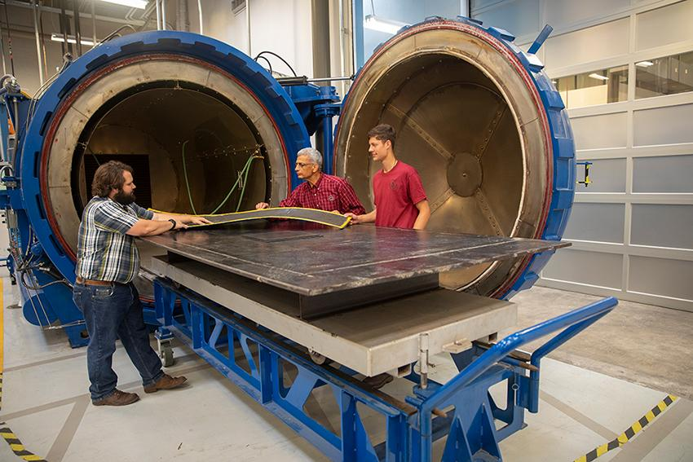
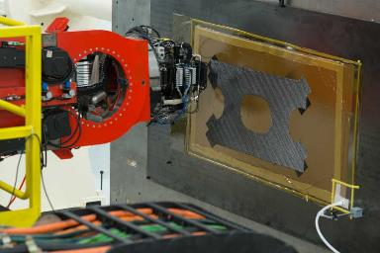
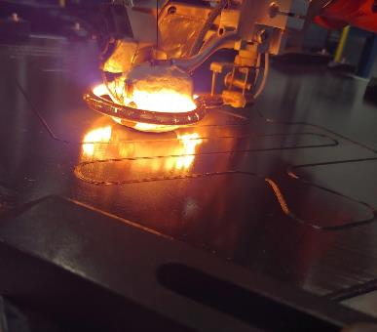
Automated Inspection for AFP
Additive Continuous Fiber
Fastener Free Assembly
Industrial Scale AFP
Advanced Heating Systems
High-Temp. Autoclave
Complex Geometries
In-situ Sensing
UofSC’s unique advanced composites manufacturing equipment and capabilities are actively sought by a diverse set of industrial partners, resulting in transition of technology.

Slide 10
contact: Paul Ziehl; ziehl@cec.sc.edu

