Slide 1
CSCE 190
Careers in Computer Science, Computer Engineering, and Computer Information Systems
Fall 2015
Marco Valtorta
mgv@cse.sc.edu

Slide 2
The Job Market

Slide 3
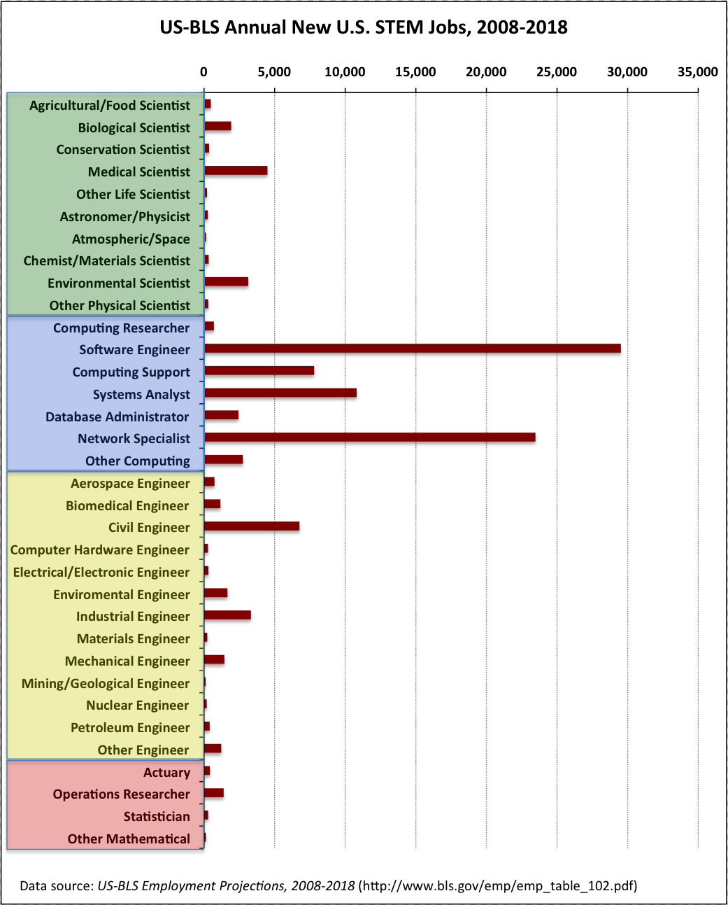
US Bureau of Labor Statistics:
New US STEM Jobs per Year, 2008-2018
Notes:
Source: Joel Adams, Calvin College, http://cs.calvin.edu/p/ComputingCareersMarket, via CSTA web site (http://blog.acm.org/archives/csta/points_of_interest/)
There are lots of myths about computing careers. One of the most ridiculous is the myth that all the computing jobs are going overseas. By contrast, the U.S. Bureau of Labor Statistics (US-BLS) predicts that computing will be one of the fastest-growing U.S. job markets in science, technology, engineering, and mathematics (STEM) for the foreseeable future, as indicated on the following chart (on powerPoint chart).
As you can see, the US government is predicting that the vast majority of the new STEM jobs will be in computing; only one other area (civil engineering) is expected to generate more than 5000 new jobs per year. By contrast, the US-BLS predicts there will be over 25,000 software engineering jobs each year, over 20,000 network specialist jobs each year, and over 10,000 systems analysts jobs each year.

Slide 4
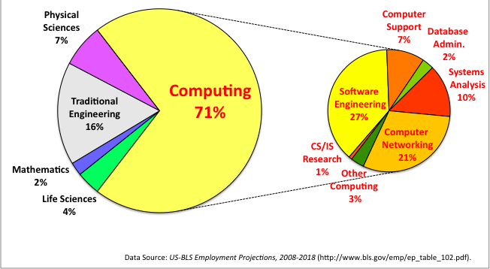
Percentage of New STEM Jobs by Area through 2018
Notes:
For the foreseeable future, nearly 3 out of 4 new science or engineering jobs in the U.S. are going to be in computing! By contrast, just 16% will be traditional engineering jobs, and even fewer will be in the sciences or mathematics.
What kind of “computing” jobs are these? The pie-chart on the right (PowerPoint chart) breaks the “computing” jobs down in the different career categories, and shows that the US-BLS is predicting:
27% (295,200 jobs) of the new STEM jobs will be in software engineering alone as compared to 16% (178,400 jobs) in the rest of engineering combined!
There will be far more new jobs in network analysis and administration (235,700) than in traditional engineering.
Note that basic computer literacy (i.e., knowing Microsoft Word, Excel, or Powerpoint) or CAD-design will not qualify you for one of these jobs. These jobs require skills that you will only gain by studying computer science, information systems, and/or software engineering.

Slide 5
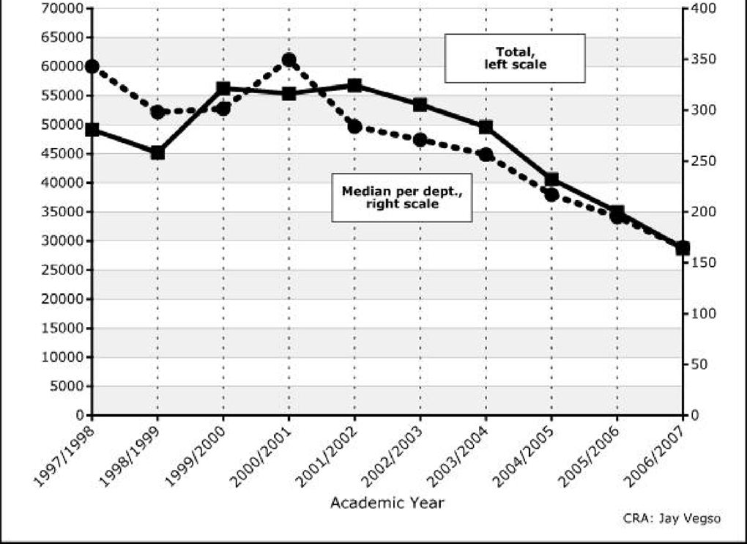
Undergraduate CS Degree Enrollment
Notes:
(Source: CRA Taulbee Survey)
With all of these jobs out there, you’d expect students to be flocking to computing. Unfortunately, the opposite is true, as the following chart shows (chart on PowerPoint slide).
So demand for software engineers, network administrators, systems analysts, and other computing-related professionals is exploding, but fewer and fewer students are choosing to study what is needed to get these jobs. As a result, salaries for these professionals are climbing.

Slide 6
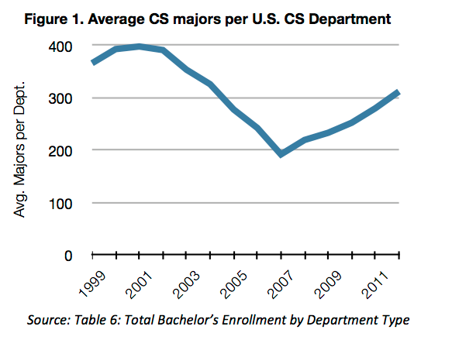
Undergraduate CS Degree Enrollment
Notes:
(Source: CRA Taulbee Survey, http://cra.org/govaffairs/blog/2013/03/taulbeereport/)

Slide 7
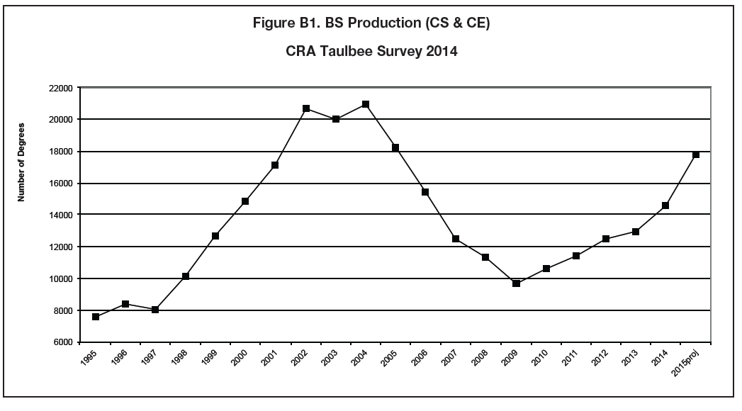
Undergraduate CS Degree Enrollment
Notes:
(Source: CRA Taulbee Survey, http://archive2.cra.org/uploads/documents/resources/crndocs/issues/0515.pdf, p.24)

Slide 8
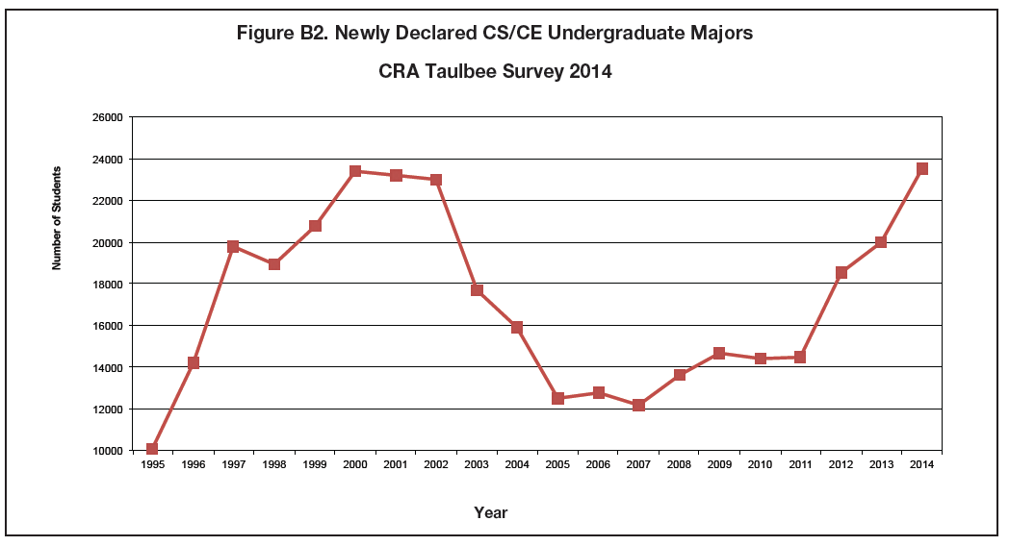
Undergraduate CS Degree Enrollment
Notes:
(Source: CRA Taulbee Survey, http://archive2.cra.org/uploads/documents/resources/crndocs/issues/0515.pdf, p.25)

Slide 9
Starting Salaries
The winter 2011 yearly salary survey by the National Association of Colleges and Employers (NACE) reported that the average salary offer made to the class of 2011 graduates in computer engineering, information systems, and computer science increased to $59,298, $49,318, and $61,783, respectively. All of these are among the top paid bachelor’s degrees.

Slide 10
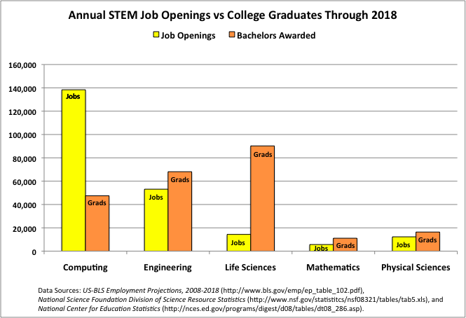
Notes:
If you’re not convinced, this final chart compares the number of graduates vs. new jobs in broad science and engineering (S&E) categories.
The yellow bars indicate the total number of job openings in each area per year, and the orange bars indicate the number of graduates in those areas. In engineering, the physical sciences, and the life sciences, there are more graduates than there are jobs. This means the graduates from these programs will be competing for the available jobs, when tends to keep salaries flat.
But in computer science, there is a huge undersupply of graduates. As in any situation where demand exceeds supply, companies are competing for the (relatively few) available graduates that have advanced computing skills, driving salaries up. This is creating a “perfect storm” for people with suitable gifts in STEM and degrees in computing-related fields, as they have a wealth of career options from which to choose.

Slide 11
Computing Careers
Notes:
http://computingcareers.acm.org/

Slide 12
Computing Disciplines
Computer Engineering
Typically involves software and hardware and the development of systems that involve software, hardware, and communications.
Computer Science
Currently the most popular of the computing disciplines; tends to be relatively broad and with an emphasis on the underlying science aspects.
(Computer) Information Systems
Essentially, this is computing in an organizational context, typically in businesses.
Notes:
http://computingcareers.acm.org/?page_id=6
These three disciplines correspond to the three undergraduate majors offered in the CSE department

Slide 13
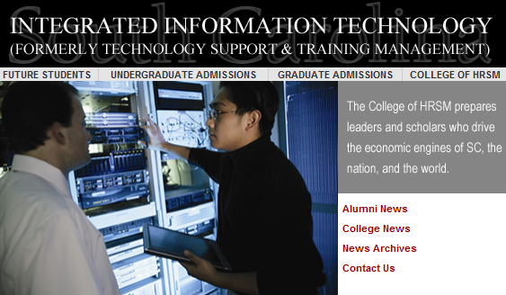
Computing Disciplines (ctd.)
Information Technology
Focuses on computing infrastructure and needs of individual users; tends to involve a study of systems (perhaps just software systems, but perhaps also systems in support of learning, of information dissemination, etc.).
Software Engineering
Focuses on large-scale software systems; employs certain ideas from the world of engineering in building reliable software systems.
Notes:
http://computingcareers.acm.org/?page_id=6
The Information Technology discipline is closer to the TSTM (Technology Support and Technology Management) major, which is offered in the school of Hospitality, Retail, and Sports Management:
The Integrated Information Technology Program (iIT)—formerly Technology Support and Training Management—is part of USC‘s College of Hospitality, Retail, and Sport Management. Students in the iIT program receive an in-depth background in information technologies in four major areas. These areas include computer networking, database systems, corporate training and development, and end-user support. In the computer networking area, students learn about networking theory, hardware, configuration, design, installation, and network operating system administration. In the database systems area, students learn to create and maintain databases through courses in Access, Visual Basic (for database integration), Oracle, and Systems Analysis and Design. The training area covers both the human side of corporate training, as well as the technical side of training materials development. The final area emphasizes end-user support which includes help desk
To maximize the learning experience, all iIT students must complete a capstone course that incorporates all four core areas. In this course, student teams work with a real business, solve an actual system issue, and design the needed system. Additionally, they must complete an internship as a final requirement for the program. Students graduating from this program have a very diverse IT background and have obtained positions in a wide range of organizations ranging from Network Administrator to Database Administrator to Director of Information Technologies. The program places emphasis on technology-based decision making and information management skills in dynamic business environments.
Technology Support and Training Management Program gets new name
Technology Support and Training Management Program at the University of South Carolina has changed its name to Integrated Information Technology (iIT). The name change is effective immediately.
“The new name expresses what we do much better than the old name,” said Dr. Bob Brookshire, the Program’s Director. “Our curriculum and our faculty’s research integrate the disciplines of database management, network management, web development, and information technology training. The old name really reflected only part of what our program is about.”
Information technology industry executives support the name change. “I strongly endorse the name change,” said Andy Bernardin, Client Director with IBM. “I have found the faculty and staff to be in tune with the day-to-day information technology needs business have in South Carolina. They have been proactive in helping to meet those needs by producing quality students and programs.”
Steve Wiggins, chief information officer for BlueCross BlueShield of South Carolina, agrees. “We have witnessed the transformation of this program to one of the leading university programs in producing the type of candidates that are most needed by IT businesses,” he said. “This will bring the appropriate level of attention to this program through the clarity established between the name and the focus of the program.”
The name change was approved by the State of South Carolina’s Commission on Higher Education at its March 24 meeting.
For more information on the Integrated Information Technology Program, contact Bob Brookshire at brookshire@sc.edu or visit the website at http://iit.sc.ed

Slide 17
CSE Curricula

Slide 18
Curricula in the Computer Science and Engineering Department
Major references are the departmental website (http://www.cse.sc.edu/) and the University Undergraduate Studies Bulletin (http://www.sc.edu/bulletin/)
The objectives of the Undergraduate Program of Computer Science and Engineering are to provide the student with a thorough grounding in mathematics, science, and computational subjects and to prepare the student for a professional career or graduate studies in computer science, computer engineering and other fields.

Slide 19
Minor in Computer Science
CSCE 145, 146 (Algorithmic Design I and II)
CSCE 210 Computer Organization
One of several tracks:
  Artificial Intelligence
  Database
  Hardware
  Programming Languages
  Scientific Computing
  Systems Programming
  Theory of Computationa
Notes:
Note: Bulletin description is (sadly) out of date: it includes 212 without its prerequisite, 211; it includes 245, which is no longer offered

Slide 20
Three Degrees: CS, CE, CIS
The Department of Computer Science and Engineering offers baccalaureate degrees with majors in computer engineering, computer information systems, and computer science.
All three degrees provide students with the knowledge and skills needed to work as practitioners in all aspects of the computing and information processing industries. All majors include a common core of fundamental courses in computing.
  The major in computer engineering includes courses in electronics and computer hardware as well as software;
  the major in computer information systems includes courses in business and is designed for students who are primarily interested in business applications;
  the major in computer science allows students to focus primarily on the software aspects of computing and requires selection of an appropriate application area.

Slide 21
Computer Science Program Objectives
Five years after graduation, computer science graduates should be
  contributing to economic development and society through the development and management of computer systems for industry and research
  advancing in their careers through knowledge of computer science, communications skills, and understanding of computer systems and contemporary technological issues
  continuing their professional development through professional study and research

Slide 22
Computer Engineering Program Objectives
Five years after graduation, computer engineering graduates should be
  contributing to their communities and society with innovations in computer technology and applications and an understanding of contemporary technological issues
  advancing in their careers through through their knowledge of computer engineering, by communication and working effectively as team members and by interacting responsibly with others in society
  continuing their professional development through professional study and research

Slide 23
Computer Information Systems Program Objectives
Five years after graduation, computer information systems graduates should be
  contributing to economic development and society through the development and management of computer information systems for business and research
  advancing in their careers through their knowledge of computer information systems, communication skills and understanding of business and contemporary technological issues
  continuing their professional development through professional study and research

Slide 24
Application Areas and Clusters for CS
The major in Computer Science requires three advanced courses (nine hours) to be taken in an application area offered by another department. These courses should be related to the major courses taken. The combination of major courses and application area courses is referred to as a computing course cluster. Examples:
  Computer Game Design and Programming Cluster
  Scientific Computing Cluster
A minor in Mathematics is easy to obtain.
There is a well-established path to obtaining a second major in Mathematics

