Slide 1
Measuring and Fingerprinting Click-Spam in Ad-Networks
Vacha Dave*, Saikat Guha, Yin Zhang
Presented by
Akhil Reddy Katpally

Slide 2
Contents
Introduction
What is Click Spam?
Estimating Click Spam
Measuring Click Spam
Fingerprinting Click Spam
Summary

Slide 3
Online Advertisement
Online Advertising is a 43 billion dollar industry and it is growing at around 18% per annum.
Main Players in Online Advertising are
  Ad-Networks
  Publishers
  Advertisers
Pay-Per Click Advertising
  Advertiser pays to the Ad-Network for every click on the Ad.
  Ad-Network shares the revenue with publisher in 30-70 percentage.
Publishers gets the major chunk of the revenue and there is a greater possibility of publishers indulging in fraud.

Slide 4
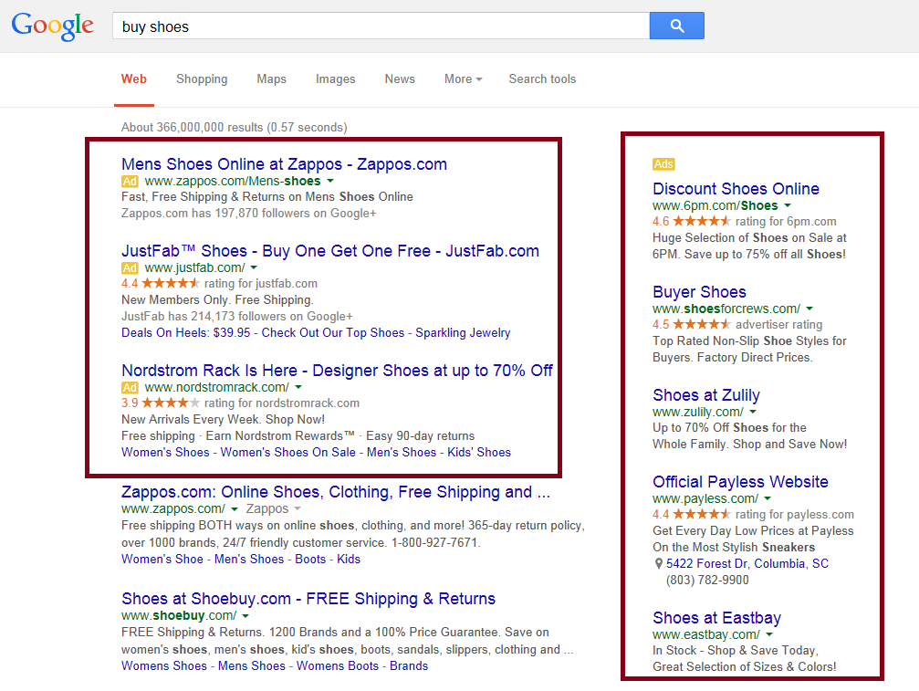
Pay-per Click
Google is Publisher and Ad networks
All ads displayed here are Advertiser ads

Slide 5
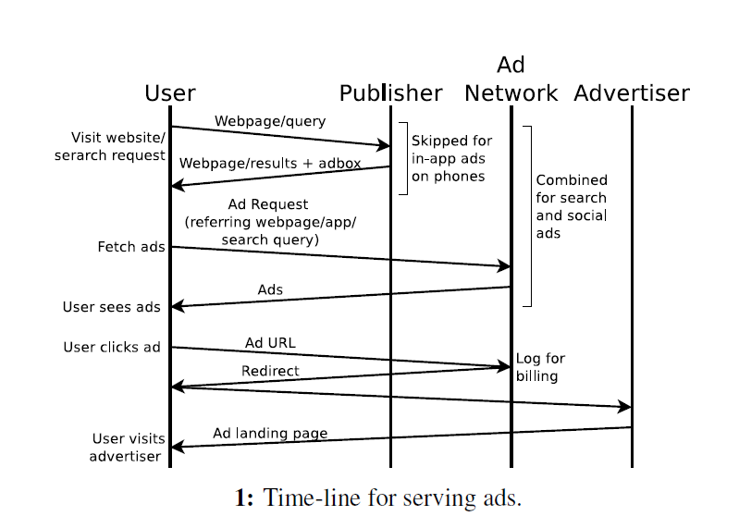
Time-line for serving Ads

Slide 6
Click Spam in Online Advertising
What is Click Spam?
  Click Spam, i.e., fraudulent or invalid click.
  A person, automated script or computer program imitates a legitimate user of web browser clicking on a ad.
  Sole purpose is generating charge per click without having actual interest.
Who is involved in Click Spam
  Publishers or Syndicated Search engine
  Advertisers
    To deplete the competitors budget.
Click Spam Costs Advertisers on the order of hundreds of millions of dollar every year.

Slide 7
Challenges in Identifying Click Spam
No ground Truth:
  A Click is Click-Spam if the user did not intend to Click.
  It is really difficult to identify which Clicks are Click-Spam.
Granularity:
  Some areas of advertising have less Click-Spam and other areas have more (mortgage ads). It is not possible to aggregate them.
No global view:
  Ad network cannot track user engagement on advertiser site, and the advertiser has no knowledge on user’s engagement with other advertiser.

Slide 8
Do Ad networks identify Click Spam?
Every Ad networks have in-house heuristics to identify Click Spam.
They provide discounts to the advertisers based on their in-house heuristics.
Ad networks do not indicate which clicks were charged and which are not charged in the billing report.
There is no transparency in this models and the efficiency of this models are questionable.

Slide 9
Contributions of the paper
First methodology to Advertisers to independently measure and compare Click Spam across each ad networks for a specific keywords.
Discover sophistication of ongoing click spam attacks and present strategies to ad networks to mitigate them.
Conduct a large-scale in-depth measurement study of click-spam today across ten ad networks.
  Search, contextual, social and mobile ad networks.
  Show that Click Spam is a problem for Mobile and Social ad networks.

Slide 10
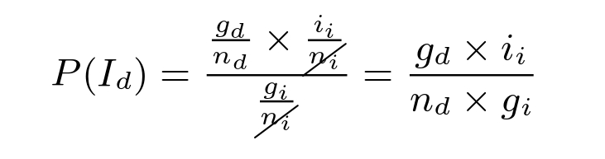
Estimating Click-Spam
We estimate fraction of click-spam in total clicks.
Designed Bayesian estimation framework. It can provide the fraction of the click-spam.
Bayesian framework uses only quantities which are measurable by the advertiser.
It will cancel out quantities which are not measurable by the advertiser.

Slide 11
Estimating click spam
P(G) is computed as the ratio of the number of gold-standard clicks (g; known) to the number of clicks (n; known).
P(Ii) is the ratio of the number of non-click-spam clicks (ii; unknown) to the number of clicks (ni; known) arriving via the interstitial page
False Positive:
  Legitimate users may not make extra effort to reach target ad.
False Negative:
  Uninterested users may still make extra effort to reach target ad.

Slide 12
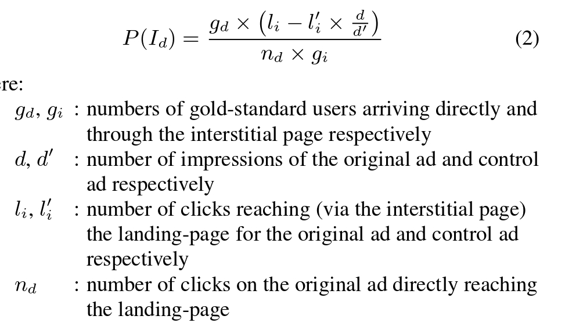
Estimating Click Spam
Limitations of our approach:
  A key limitation of our approach is that the advertiser must actively measure click spam.
  Both interstitial ad and control ad harm the user experience.

Slide 13
Measuring Click-Spam in 10 ad networks
Signup as 3 advertiser with 10 ad networks.
10 ad networks are
  Search ad networks:
    Google search and Bing search
  Contextual ad networks:
    Google AdSense and Bing Contextual.
  Mobile ad networks:
    Google Mobile, Bing Mobile, Ad Mobile and InMobi.
  Social Ad networks:
    Facebook
We use 3 keywords for each advertiser
  High popularity keyword: celebrity
  Medium popularity keyword: yoga
  Low-popularity keyword: lawnmower

Slide 14
Continued…
We create 4 Ads for each target landing page
  First Ad directly takes to landing page
  Other 3 Ads takes to interstitial pages before to the landing page.
We create 3 interstitial pages:
  5 sec wait, before landing on the page.
  Ask user to click on the link to continue to the landing page
  Ask the user to solve CAPTCHA.
We create 4 additional Control Ads for each landing page, but with junk ad text.

Slide 15
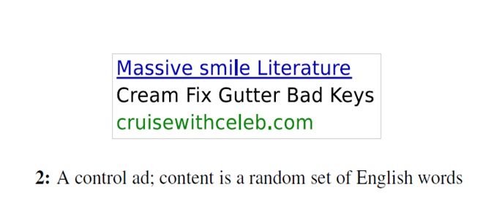
Continued….
Bluff Add
All Ads were shown 26M times.
Total of 85k clicks are resulted and 17k is charged for that.
Landing pages were fetched by total 33k unique IP addresses located in 190 countries.

Slide 16
Validating the data
Since there is no ground truth, we compare the results with the search ads of
  Google and Bing
We Assume that reputed search ad networks are mature enough that their in-house algorithms are able to detect and discount most of the click-spam on their networks.
All the web requests made to the Apache server are logged.

Slide 17
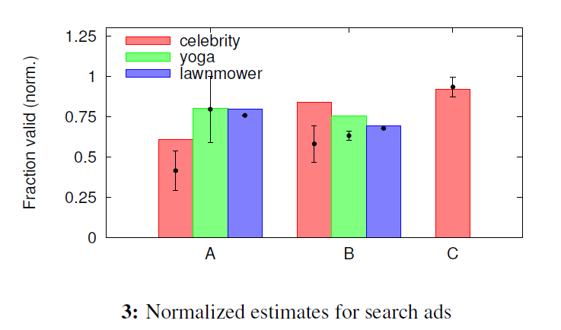
Validating using Search Ads
A,B and C are different ad networks ran with different environments

Slide 18
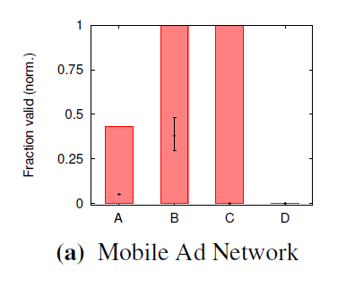
Click Spam in Mobile ads
A,B,C and D are different mobile ad networks

Slide 19
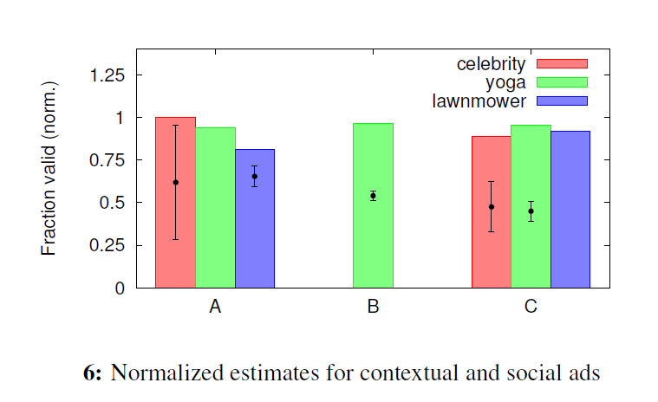
Estimating contextual spam
A,B and C are different Contextual and social ad networks

Slide 20
Fingerprinting Click Spam
Manually investigated all the clicks that were received on the control ads.
Discovered 7 ongoing click spam attacks.
Investigation covers 26% of the traffic our control ads attracted. As expected these ads are fraudulent in nature.
Normally Ad networks discount substantially less amount(6-20%).

Slide 21
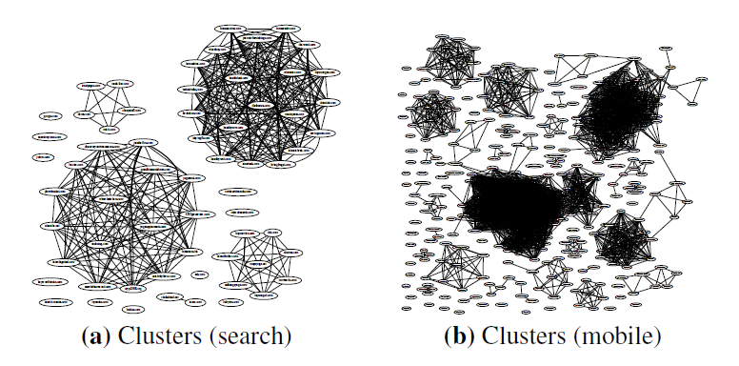
Graph Clustering
We induce a graph that spans all publisher domains we see.
For any pair of publishers, we compute a similarity score.
We construct a feature vector that consists of various network-level attributes.
By assigning weight to each attribute we compute a cosine similarity b/w the
  Feature vectors of the pairs of the domain.

Slide 22
Malware Driven Click Fraud
Responsible malware: TDL
  Validation: Run malware in Virtual Machine.
Can intercept and redirect all requests from popular browsers.
  Browser specific filtering doesn’t work.
Only 1 click per ip address per day.
  Threshold based filtering doesn’t work.
Mimics real user behavior
  Timing analysis doesn’t work.

Slide 23
Click Fraud using parked domains
A parked domain is a domain that is registered but it is not in use.
IP holds 500,000 such domains.
A user may reach parked domain through many ways like he may have mistyped the website name.
  Advertiser must pay for that.
Auto redirects based on the geo-location.

Slide 24
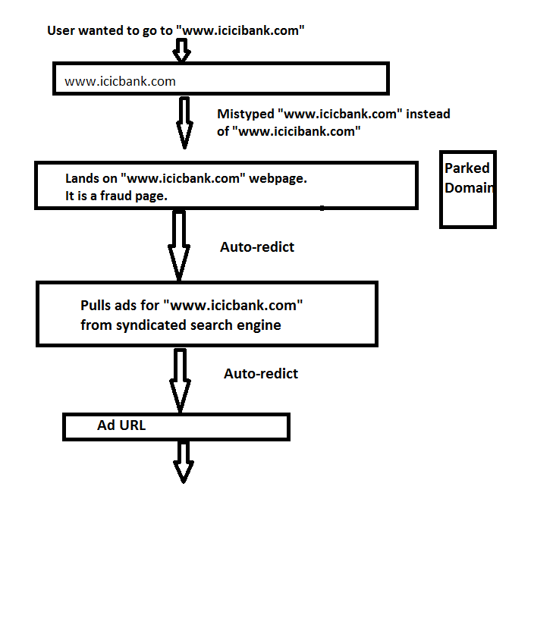
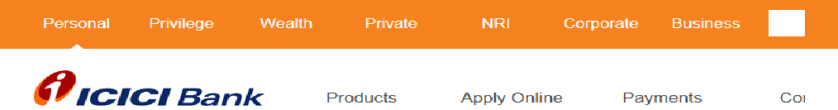
Icici bank parked domain
Finally user reaches to
www.icicibank.com

Slide 25
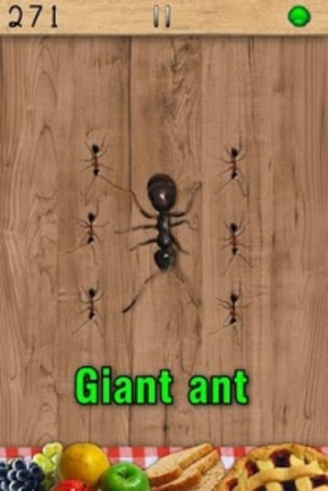
Mobile Click Spam
Gamming apps
  Place ads close to where users are expected to click.
  Games like Ant-smasher, milk-the-cow, and others.
Ant-smasher
  Ads are placed where user is expected to click
Click Spam is rampant in mobile ads.

Slide 26
Summary
Click Spam remains a problem, and probably lot bigger in mobile ads.
Proposed an independent mechanism to estimate click spam by the advertiser.
Done extensive validation with different set of keywords in different ad networks.
Learnt about sophisticated Click Spam attacks like
  Malware driven attacks
  Parked domain Click Spam
  Mobile Click Spam

Slide 27
Any Questions?

